Slide 1

Artificial intelligence
Hossam Elsayed MohaMED Fakher
0 1 2 7 7 8 8 0 6 7 8
Gmail
GitHUB
Linkedin
Kaggle
S e s s I o n 3
CNN

Slide 2
Image
Computers Sees An Input Image As Array Of Pixels And It Depends On The Image Resolution.
It Will See
H X W X D
( H = Height, W = Width, D = Dimension ).

Slide 3
Convolutional neural network (CNN)
CNNs designed for working with two-dimensional image data, also they can
be used with one-dimensional and three-dimensional data.
Convolutional neural network is one of the main categories to do:
– images recognition
– images classifications
– Objects detections
– recognition faces
– etc.

Slide 4
CNN Architecture

Slide 5
Convolutional Layers
• Convolution is the first layer to extract features from an input image.
• Convolution keeps the relationship between pixels by learning image features using small squares of input data.
• It is a mathematical operation that takes two inputs such as image matrix and a filter or kernel.
Contains:
• Padding
• Stride
• Activation Function
(0*0) + (-1*0) + (0*0)
(-1*0) + (5*60) + (-1*113)
(0*0) + (-1*73) + (0*121)
= 114

Slide 6
Strides
•Stride is the number of pixels shifts over the input matrix.
•When the stride is 1 then we move the filters to 1 pixel at a time. When the stride is 2 then we move the filters to 2 pixels at a time and so on.

Slide 7
Padding
– Pad the picture with zeros (zero-padding) so that it fits (called Same Padding)
– Drop the part of the image where the filter did not fit. This is (called valid padding) which keeps only valid part of the image.

Slide 8
Padding In RGB

Slide 9
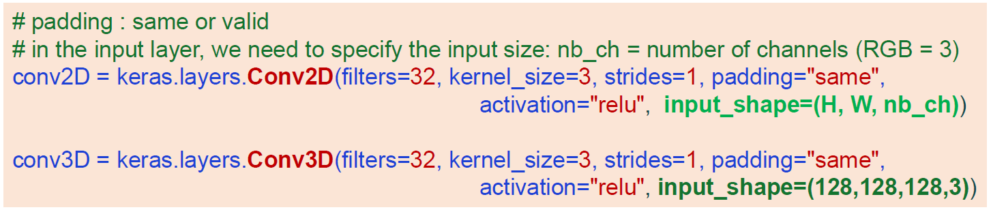
Convolutional Layers
• Padding
• Stride
• Activation Function

Slide 10
Convolutional Layers
Calculate the output size in the convolution layer? We can use this
formula (output height or output width): [(W−K+2P)/S]+1.
W : is the input volume
K : is the Kernel size
S : is the stride
F : is n_filters
input image: W * H = 12*12, K = 5, S = 1, n_filters = 256
output :
W = [(w-k)/s]+1 = [(12-5)/1]+1 = 8
H = [(h-k)/s]+1 = [(12-5)/1]+1 = 8
output image = H*W*n_filters = 8*8*256
Pooling layer:
Wout = [(W-K)/S]+1

Slide 11
Convolutional Layers

Slide 12
Pooling Layer
Pooling is a down-sampling operation that reduces the dimensionality of the feature map and reduce the number of parameters when the images are too large which reduces the dimensionality of each map but retains important information.
types:
–Max Pooling
–Average Pooling

Slide 13
Pooling Layer
• Max pooling: takes the largest element from the rectified feature map.
• Average pooling: Takes the average of all element.

Slide 14
Pooling Layer
Global Average Pooling
Global Max Pooling

Slide 15
Flatten layer

Slide 16
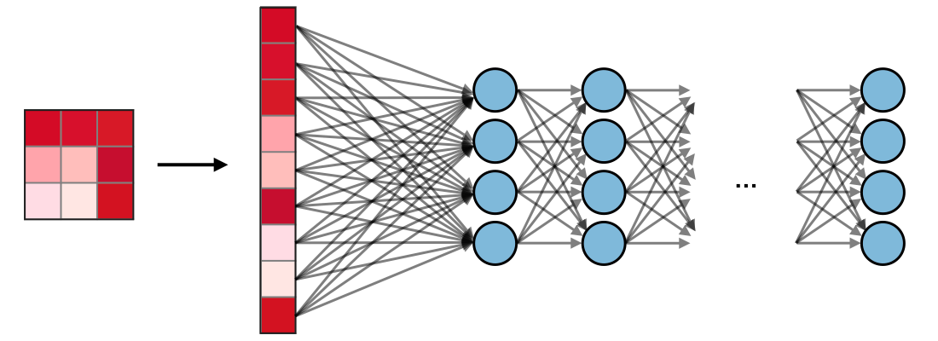
Fully Connected (FC)
The fully connected layer (FC) operates on a flattened input where each
input is connected to all neurons. If present, FC layers are usually found
towards the end of CNN architectures and can be used to optimize
objectives such as class scores.

Slide 17
CNN

Slide 18
Avoiding Overfitting
Initialization Weights And Kernal
Activation Function
Optimizer
Learning_rate
ℓ1 And ℓ2 Regularization
Batch Normalization
Dropout
Callbacks
Kfold CV
Data Augmentation

Slide 19
1- Initialization Weights And Kernal
• Applying a good initialization strategy for the connection weights
• kernel_initializer="he_uniform" or "he_normal", "glorot_uniform“
keras.layers.Dense(10, activation="relu", kernel_initializer="he_normal")

Slide 20
2- Activation Function
The ReLU activation function is not perfect. It suffers from a problem known as the dying ReLUs: during training, some neurons effectively “die”, meaning they stop outputting anything other than 0.
To solve this problem, you may want to use a variant of the ReLU function,such as the leaky ReLU , the exponential linear unit (ELU), or the Scaled ELU (SELU) activation function.
Layer = keras.layers.Dense(10, activation=keras.layers.LeakyReLU(alpha=0.02) )
Layer = keras.layers.Dense(10, activation="selu", kernel_initializer="lecun_normal")

Slide 21
3- Optimizer
https://keras.io/api/optimizers/
Using faster optimizer (Gradient Descent, Momentum Optimization, Nesterov Accelerated Gradient, AdaGrad, RMSProp, Adam, Nadam).
opt = keras.optimizers.Adam(lr=0.1, beta_1=0.9, beta_2=0.999)

Slide 22
4- Learning Rate
Update the optimizer’s learning_rate attribute at the beginning of each epoch:
lr_scheduler = keras.callbacks.ReduceLROnPlateau(factor=0.2, patience=5, min_lr=0.0001)
history = model.fit(X_train, y_train, [...], callbacks=[lr_scheduler])

Slide 23
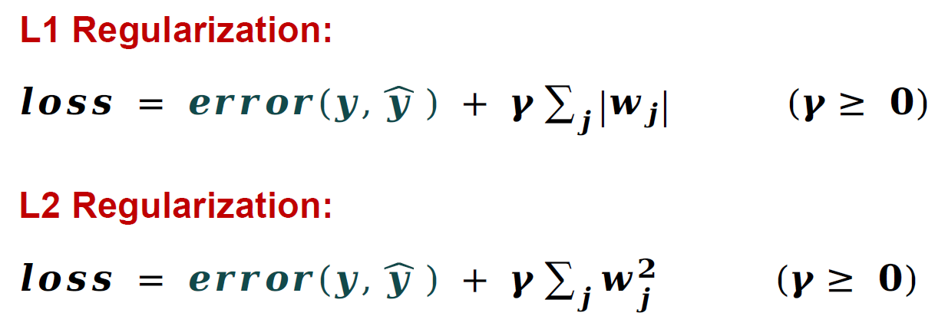
5- ℓ1 and ℓ2 Regularization
Regularisation is a process of introducing additional information in order to prevent overfitting.
layer_h_n = keras.layers.Dense(100, activation="relu",kernel_initializer="he_normal",
kernel_regularizer=keras.regularizers.l2(0.01))
# kernel_regularizer=keras.regularizers.l1(0.01))
• l1 : keras.regularizers.l1(0.01)
• l1 + l2 : keras.regularizers.l1_l2()

Slide 24
6- Batch Normalization
model = keras.models.Sequential([
keras.layers.Flatten(input_shape=[28, 28]),
keras.layers.BatchNormalization()
])

Slide 25
7- Dropout
Dropout: Connections between consecutive layers are randomly dropped
based on a dropout-ratio and the remaining network is trained in the current
iteration. In the next iteration, another set of random connections are dropped.
Code :
model.add(keras.layers.Dropout(0.3))

Slide 26
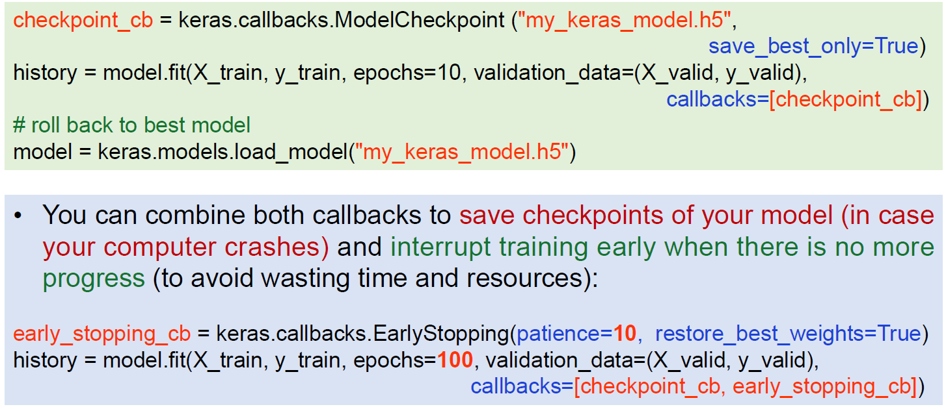
8- Callbacks

Slide 27
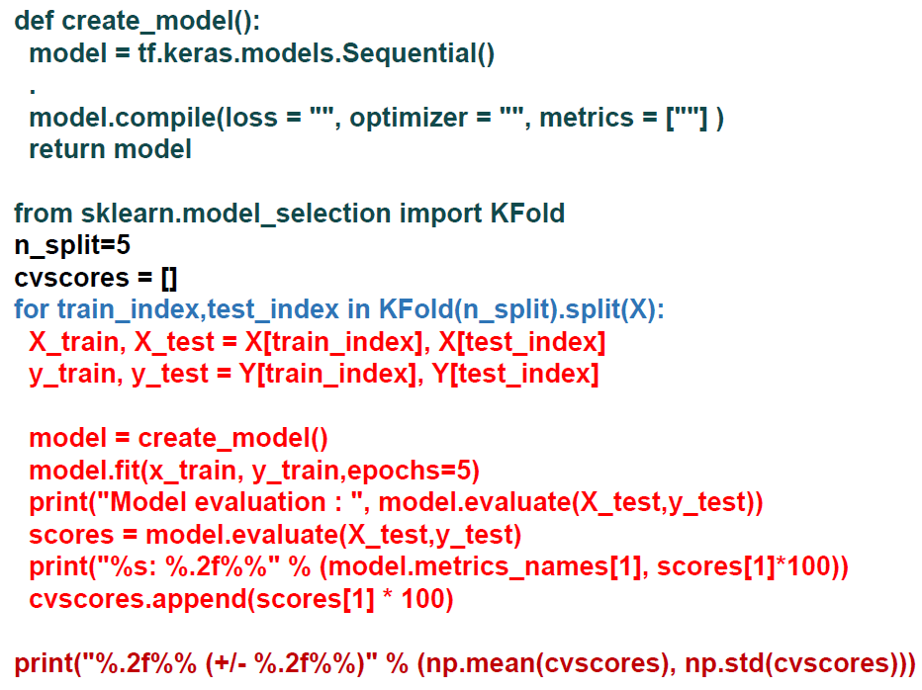
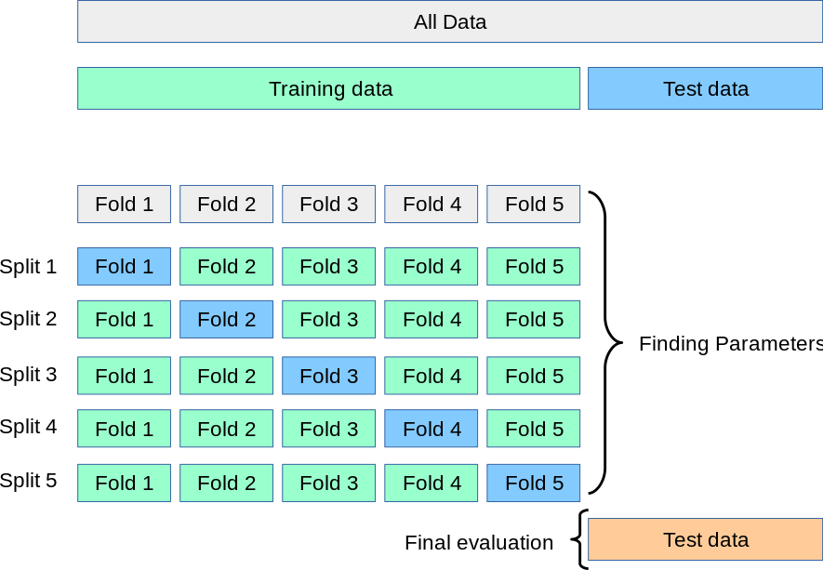
9- KFold CV
When this process is completed,you will end up with K accuracy values, one for each model. Then you can compute the mean and standard deviation of all the accuracy scores and use it to get an idea of how accurate you can expect the model to be.

Slide 28
10- Image Augmentation
Image augmentation is an engineered solution to create a new set of images by applying standard image processing methods to existing images.
methods:
– Rotation
– Zoom
– Height and width shifting
– shear
– Lighting transformations
– Crop
– Noise addition
– Cutout or erasing

Slide 29
How to Save and Load Your Model
Saving the model:
model.save("my_keras_model.h5")
Loading the model:
model = keras.models.load_model("my_keras_model.h5")

Slide 30
Thanks for listening

